Slide 1
Statistical analysis of systematic differences in the calculated pollutant concentrations of the models ECMWF / CAMS (Regional Reanalysis) and Polyphemus / DLR
Date: 08.04.2022
Sathish Kumar Vaithiyanadhan
Supervisors:
M.Sc. Lorenza Gilardi
Dr.rer.nat. Frank Baier

Slide 2
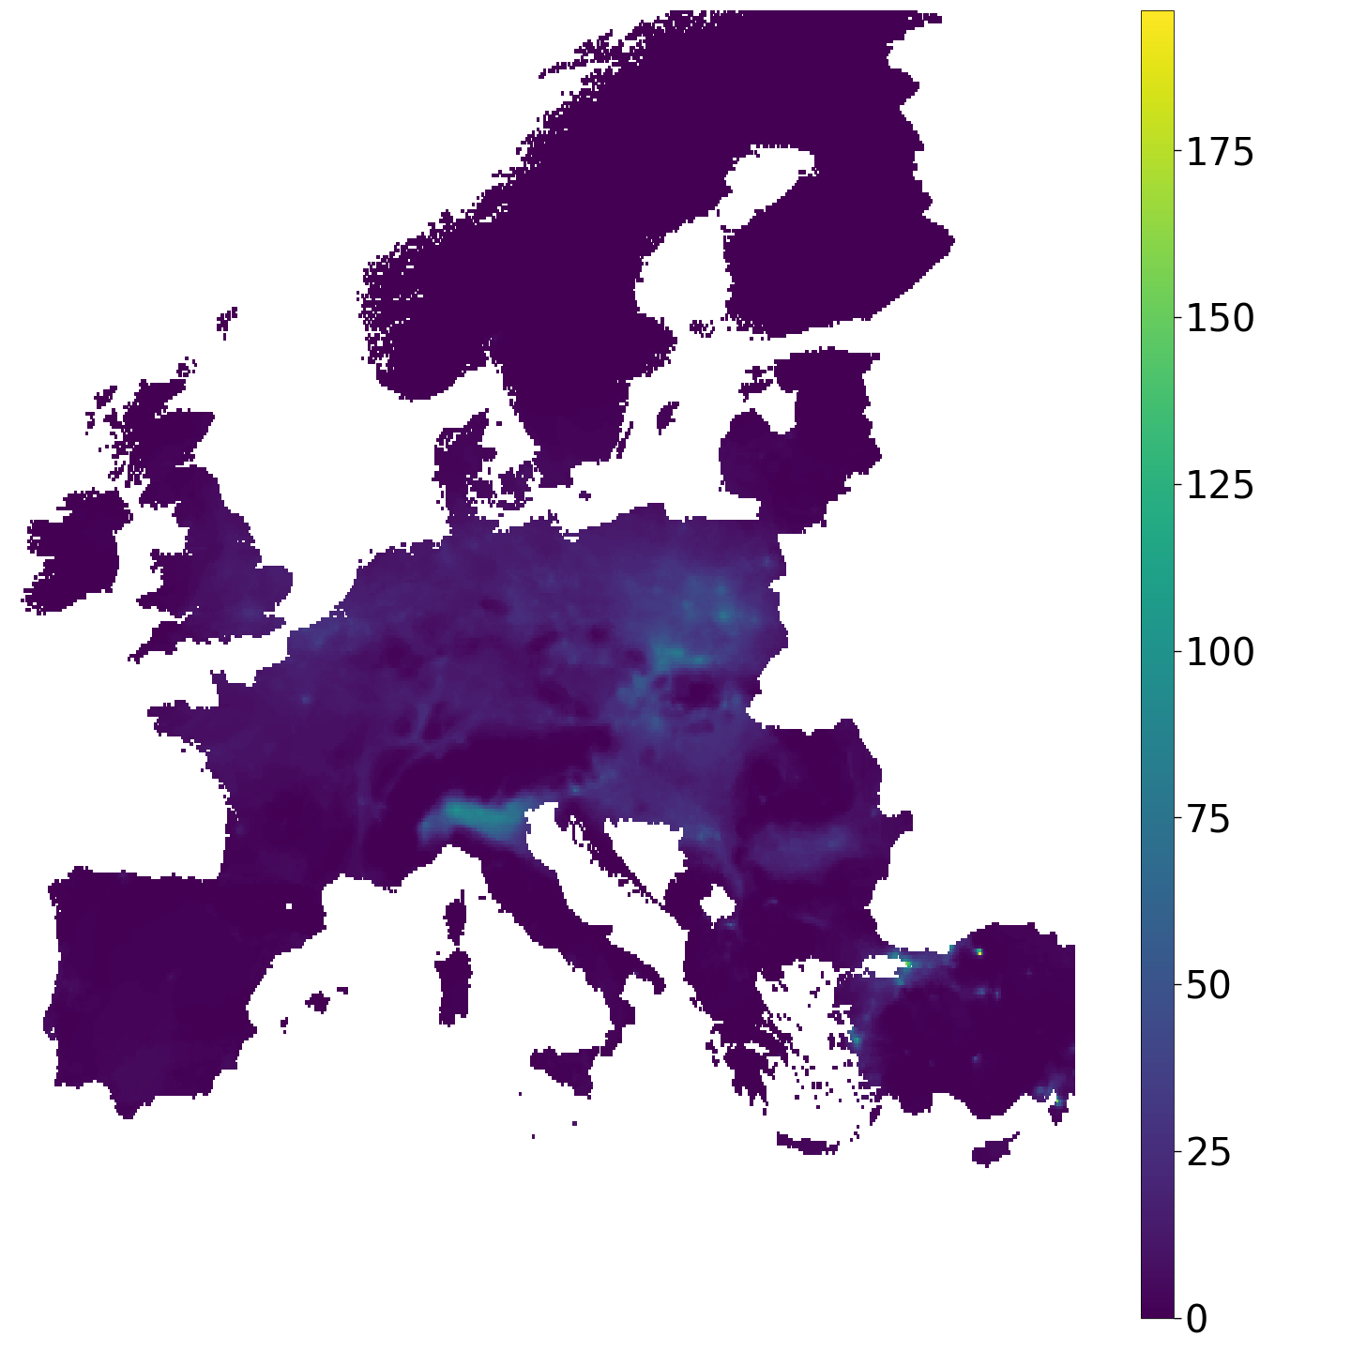
Number of days above WHO limits for PM_{2.5} in 2017 (25 µg/m³ daily mean). Source data: CAMS reanalysis Europe.
MOTIVATION
8% of the EU-28 urban population exposed to PM_{2.5} concentrations exceeding the EU limit value
77% of the EU-28 urban population exposed to PM_{2.5} concentrations above the WHO Air Quality Guidelines value.
Source: European Environment Agency’s 2019 Air Quality Report
Need method to identify urban area in higher need of intervention
Production of risk maps for metropolitan areas and other regions.

Slide 3
MOTIVATION
Chemical Transport Model (CTM) can be used in the assessment of air pollution.
Significant deviations in the concentrations between the models considered.
Comparison and verification of these models with multiple data sources helps to understand the model performances and its applications in future.

Slide 4
Scope of the work
A comparison between the outputs of the Copernicus Atmospheric Monitoring Service (CAMS) reanalysis data and of the chemical transport model Polyphemus/DLR, with reference to European Environmental Agency (EEA) station datasets.
Predictive Analysis to identify the importance of the parameters in the Polyphemus model with predicting concentrations from in-situ observations.

Slide 5
Research questions
How the overestimation/underestimation of the pollutants’ concentrations affects the performance of the models?
How extensive is the deviation between the two models with respect to station data?
Are there spatial patterns and temporal trends observable in the deviation? (Due to seasonal effects or different background conditions)
Can hypotheses be formulated to identify the potential drivers causing Polyphemus deviations with respect to CAMS and station data in urban and rural areas?

Slide 6
Thesis Outline
Data Formatting
Regridding, Timestep corrections, AOI extraction, Monthly, yearly data
Comparing Station data
Statistical Indicators
Model datsets vs EEA Station data
Predicitve analysis
Mean, SD, RMSE, MB, FGE, Correlation, Trend analysis .
Random Forest Algorithm – To predict Conc.

Slide 7

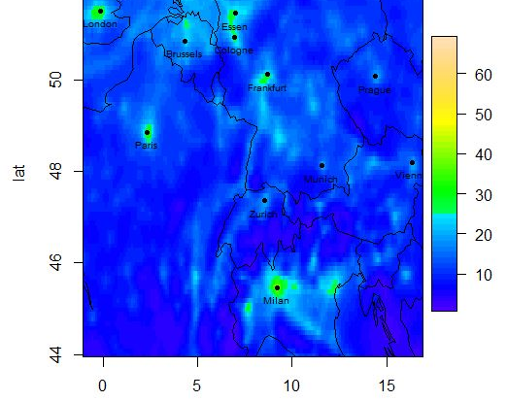
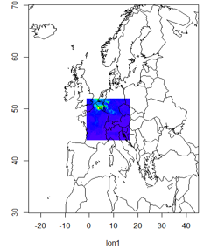
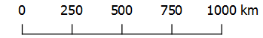
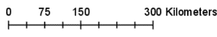
AREA OF INTEREST - Central European Union domain (corresponding to POLYPHEMUS/DLR domain 2).
Extent of Polyphemus – Domain 2.
Central European Region.
BBOX (-1.0625, 16.9375, 43.96875, 51.96875)
Pollutants Considered: NO2, O3, PM10, PM2.5.
Time Period: June 2016 – Dec 2018
Data Format: NetCDF
NO2 Emission in the AOI (Extent of Polyphemus)

Slide 8
Data sources
 | CAMS (Copernicus Atmosphere Monitoring Service) regional reanalysis | POLYPHEMUS/DLR | EEA Air quality station data
Data | Pollutants concentrations | Pollutants concentration | Pollutants concentration
Data Type | Ensemble model | Ensemble model | Station data (Background)
Spatial coverage | -29. 95: 39.95 °E ; 30.05: 69:95 °N | Central Europe domain: -1.0625W, 16.9375W, 43.96875N, 51.96875N | European domain: -29. 95: 39.95 °E ; 30.05: 69:95 °N
Spatial resolution | European domain: 0.1°N, 0.1°W | Central Europe domain: 0.125°N, 0.0625°W (~ 10km²) | European domain: 0.1° N x 0.1°W
Temporal coverage | 2018* - Ongoing *previous data in MARS database | 06.2016 - today | 2013 - today
Temporal resolution | hourly | hourly | hourly
Provider | ECMWF as part of The Copernicus Programme | WDC (some products only available internally at DLR ) | EEA air quality data download portal

Slide 9

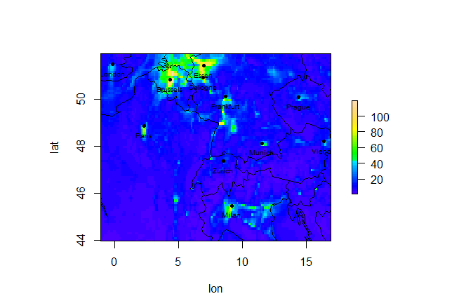
DATA FORMATING - REGRIDDING
DLR.de • Chart 9
Re-projecting the dataset from its actual grid resolution to the intended grid resolution.
Resolution:
CAMS Reanalysis: 0.1° x 0.1°
Polyphemus: 0.125°x0.0625°
Common Grid: CAMS Reanalysis
Method: Nearest Neighbor Interpolation.
Regridded Polyphemus in European extent
Cropped regridded Polyphemus in original extent
Original Polyphemus
CDO (Climate Data Operators) – Command line suite to manipulate and analyze NetCDF like Merging NetCDF, removing timesteps, extracting monthly and daily datasets etc.,

Slide 10
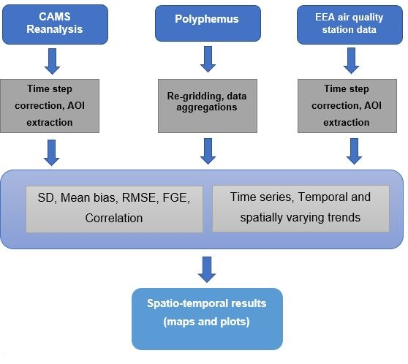
METHODOLOGY
Model/Model/In-situ comparison

Slide 11
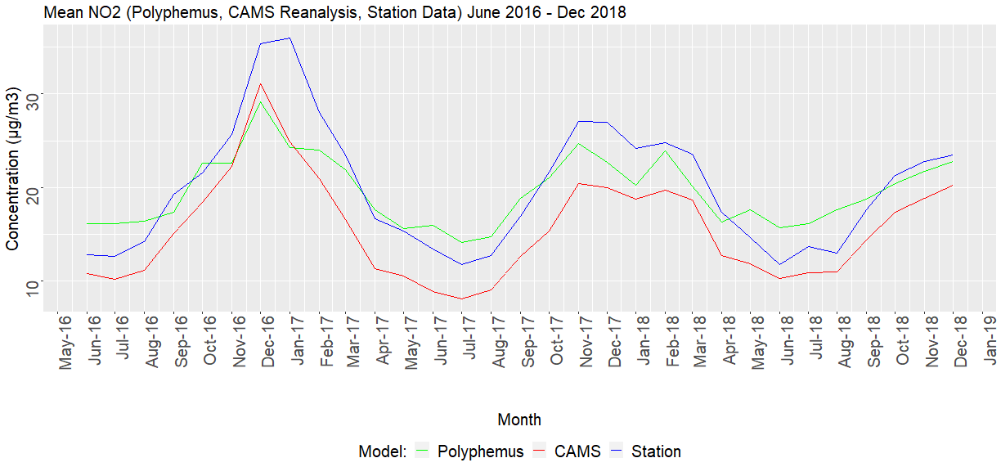
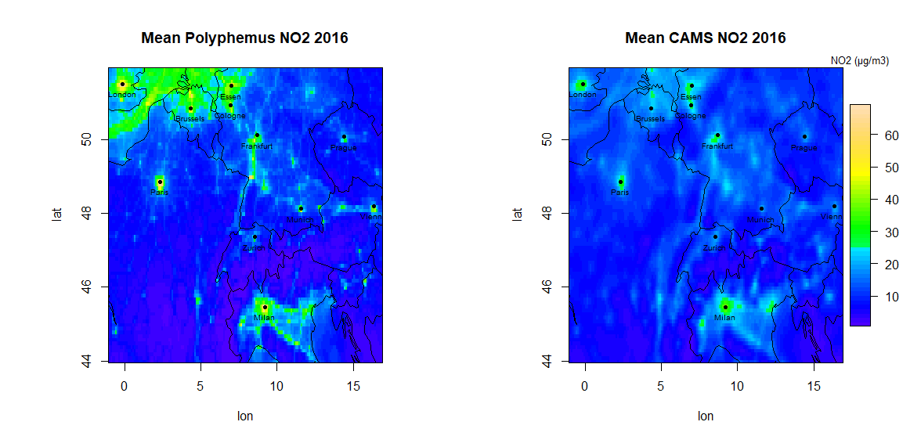
Sample Visualization:
Temporal variation (mean concentration on area of interest at stations’ location) | Spatial Variation (yearly mean concentration)

Slide 12
Results Performance of the models in urban and rural areas
Urban and rural areas in the AOI are selected to assess the behavior of the two models
Cities like Paris, Köln, Düsseldorf, Munich, Essen, Milan and Bonn were considered.
Some rural areas in Eastern & Southern France and rural areas in Austria and Czech Republic were considered.
The Polyphemus model overestimates the concentrations especially in the Urban areas over its domain and underestimates the concentrations in rural areas. CAMS reanalysis datasets are more comparable to station datasets.

Slide 13
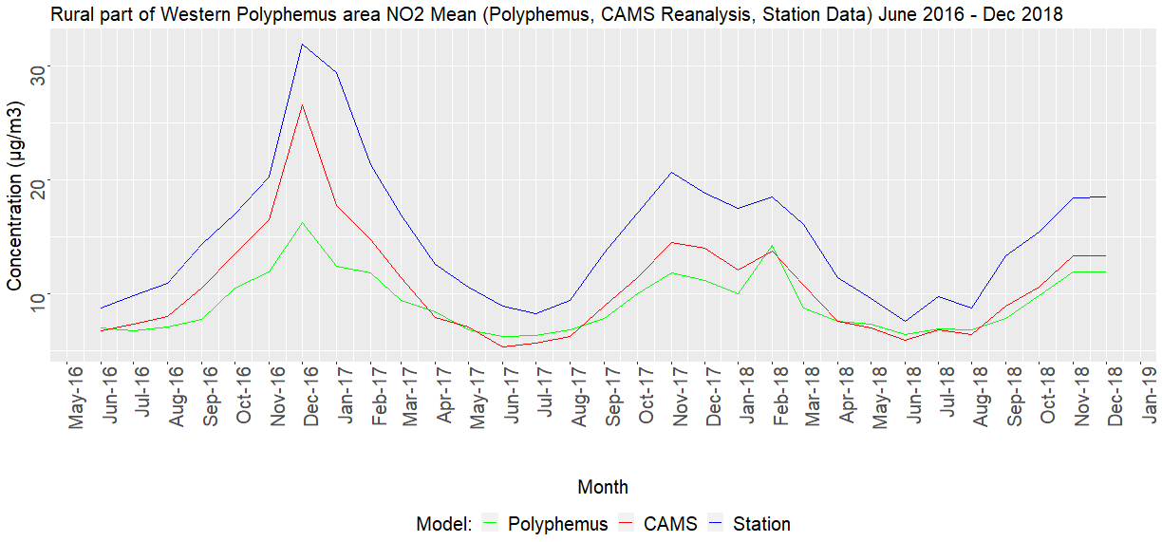
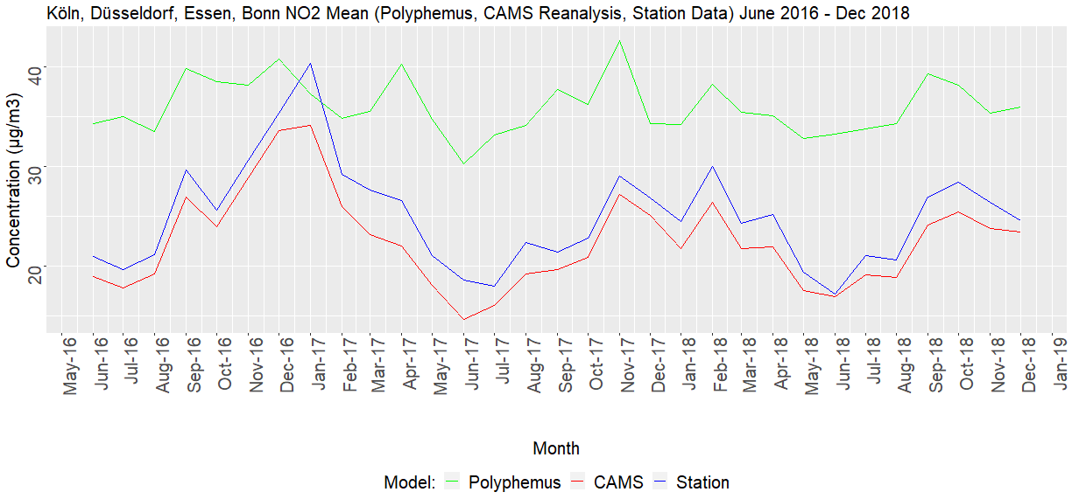
Results Performance of the models in urban and rural areas
Both models underestimate NO2 concentration at stations in rural area
No seasonal pattern visible for Polyphemus for NO2 in urban area.

Slide 14
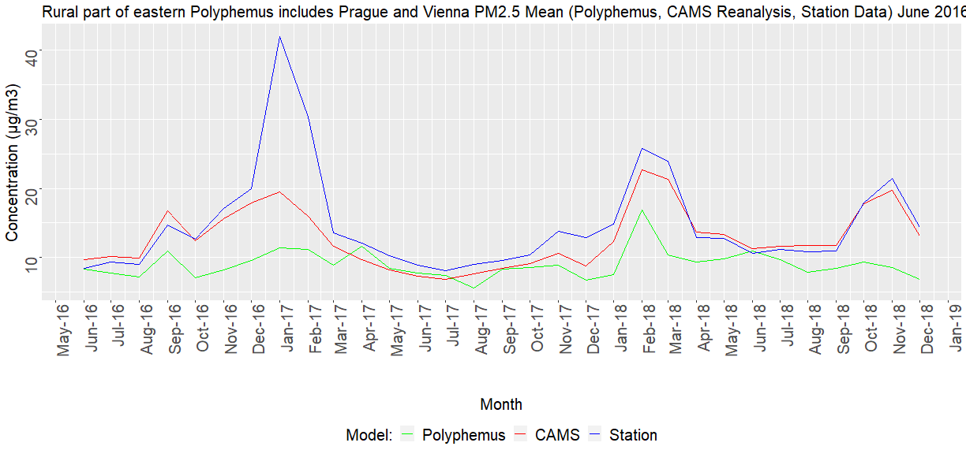
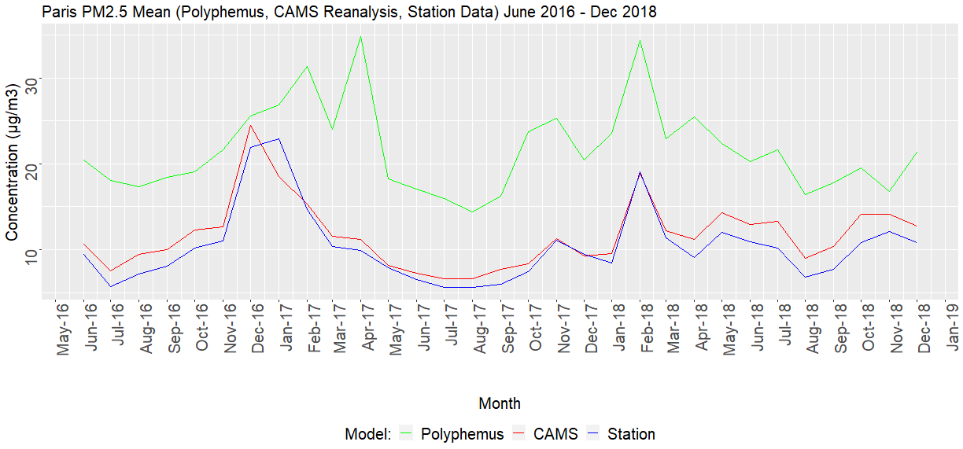
Results Performance of the models in urban and rural areas
Both CAMS and Polyphemus underestimate PM2.5 concentration at stations location
PM2.5 overestimated by Polyphemus in Paris urban area

Slide 15
Results Performance of the models in day and night times
The daytime considered from 6 AM to 6 PM
The nighttime considered from 12 AM to 6 AM
Other than O₃, all the other pollutants have similar performances during the day and night times and follow the same pattern.
There is a strong deviation in O₃ in the Polyphemus datasets with overestimation during the nighttime with respect to the station observations.

Slide 16
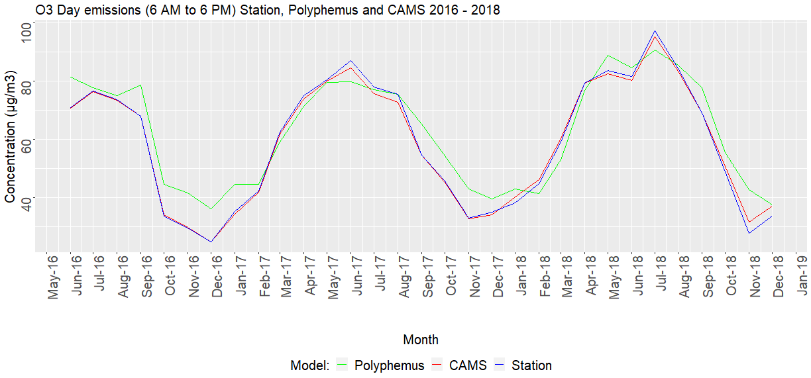
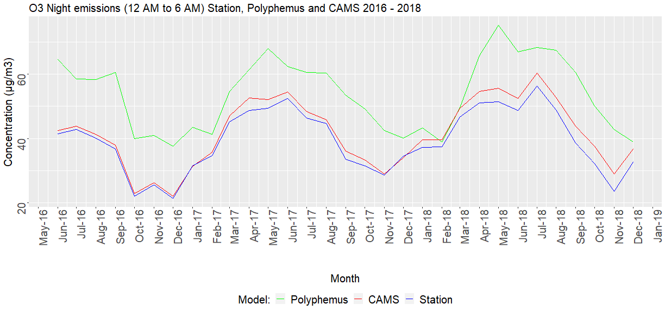
Results Performance of the models in day and night times
O3 concentration at stations’ locations in the whole area of interest during day and nighttime.
There is no significant deviations in model's outputs during daytime.
There are significant deviations observed in Polyphemus during nighttime.

Slide 17
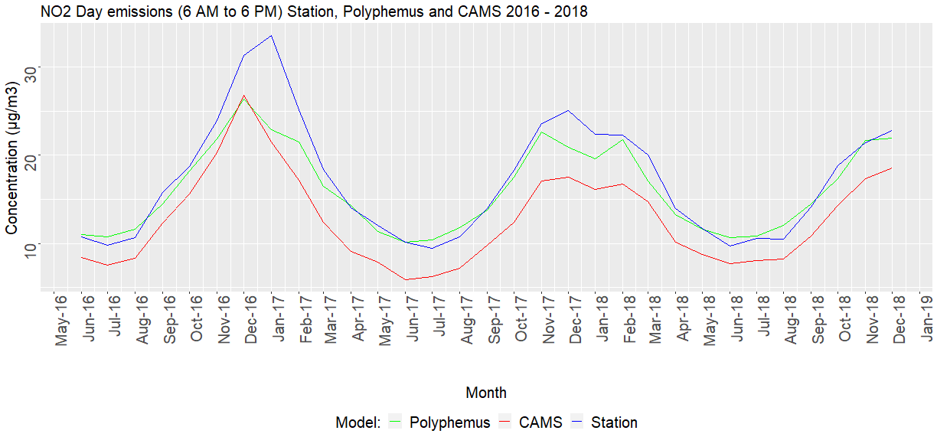
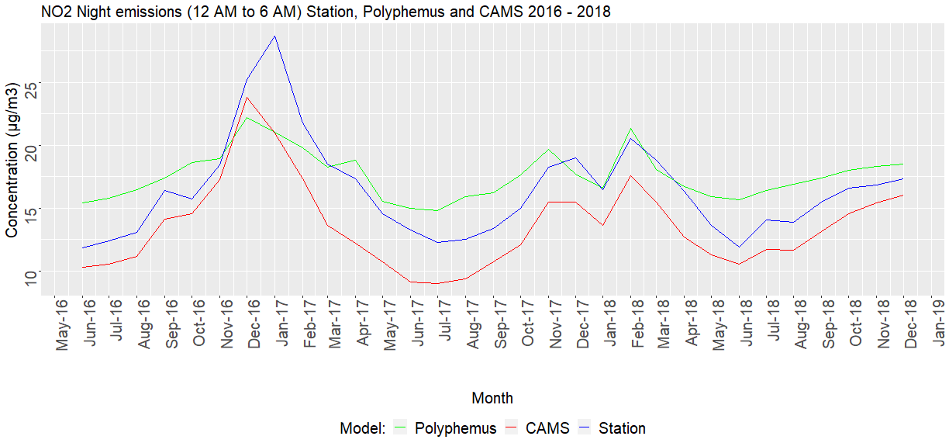
Results Performance of the models in day and night times
NO2 concentration at stations’ locations in the whole area of interest during day and nighttime.
For NO2, there is no significant deviations in model's outputs during day and nighttime.

Slide 18
Results – Statistical Indicators
Statistical analysis like Mean Bias, RMSE, FGE, correlations were checked to identify the deviation between the models and also with the station data.
The results report both the spatial and the temporal development.
Comparing the models with station data in the extent of Polyphemus, CAMS datasets are compared better to station datasets.
High seasonal deviations observed in CAMS like negative bias for urban PM2.5, negative bias for rural NO2, positive bias for urban NO2 with respect to station data.

Slide 19
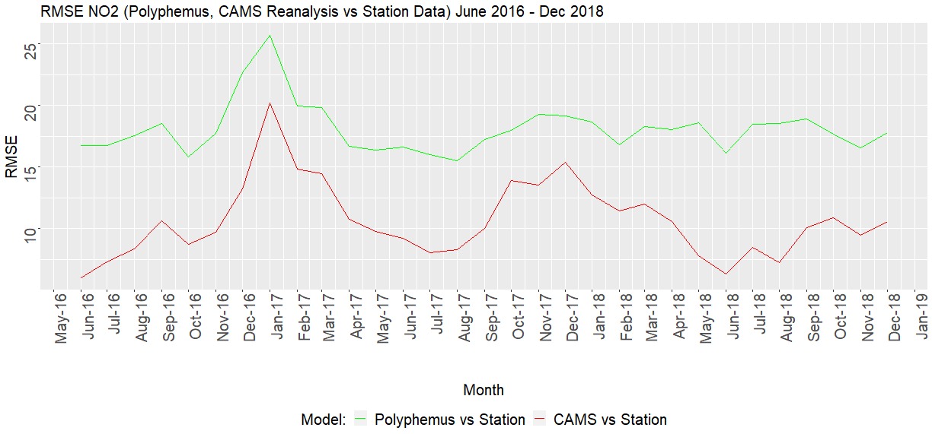
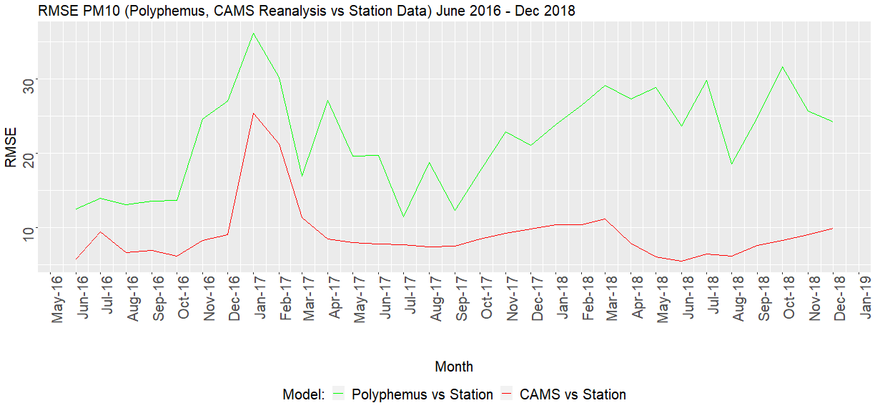
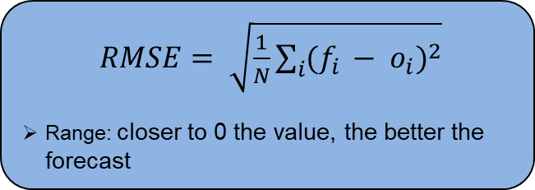
Statistical Indicators – RMSE: trends
$RMSE= \sqrt{\frac{1}{N}\sum_{i}{{(f_{i }− o_{i})}^{2}}}$
Range: closer to 0 the value, the better the forecast
RMSE observed with respect to station data for NO2 and PM10

Slide 20
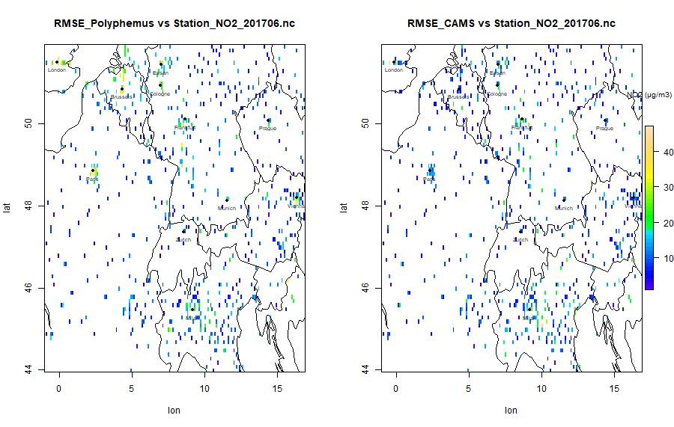
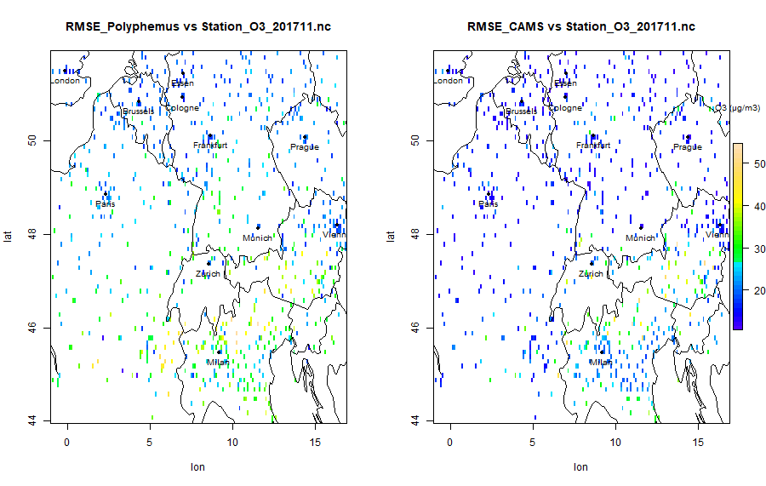
Statistical Indicators – RMSE spatial distribution
RMSE Polyphemus vs station NO2 – June 2017 RMSE CAMS vs station NO2 – June 2017
The deviations are observed in both model outputs especially in urban regions and in the Alpine area.
These deviations are observed in both summer and winter months.
For some rural regions, Polyphemus predictions are better than CAMS.
RMSE Polyphemus vs station O3 – June 2017 RMSE CAMS vs station O3 – June 2017

Slide 21
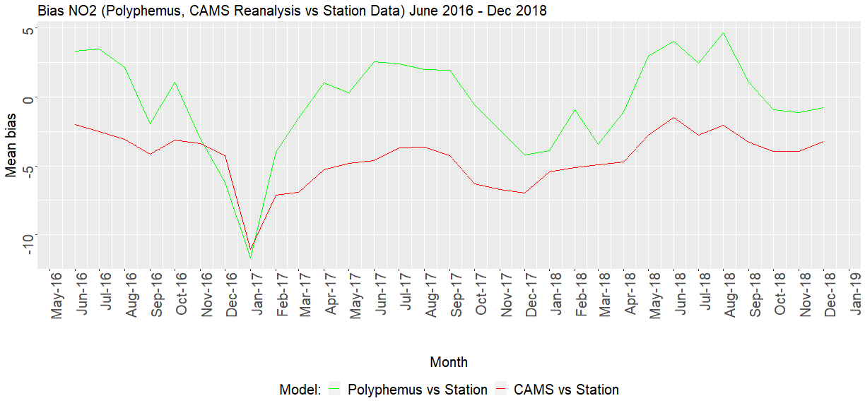
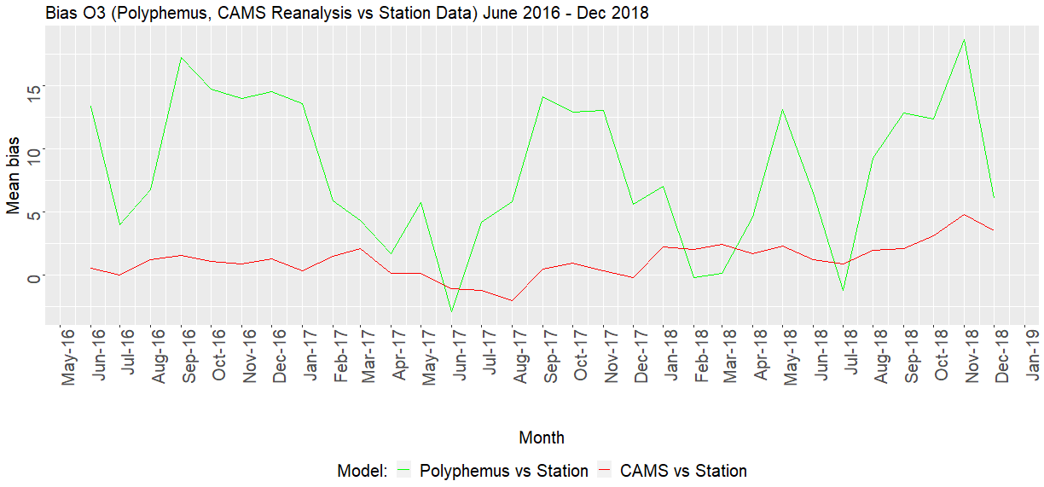
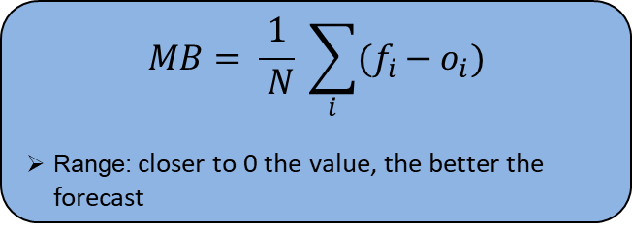
Statistical Indicators – Mean Bias: records
$$MB= \frac{1}{ N} \sum_{i}{{(f}_{i }− o_{i})}$$
Range: closer to 0 the value, the better the forecast
Mean bias observed with respect to station data for NO2 and O3

Slide 22
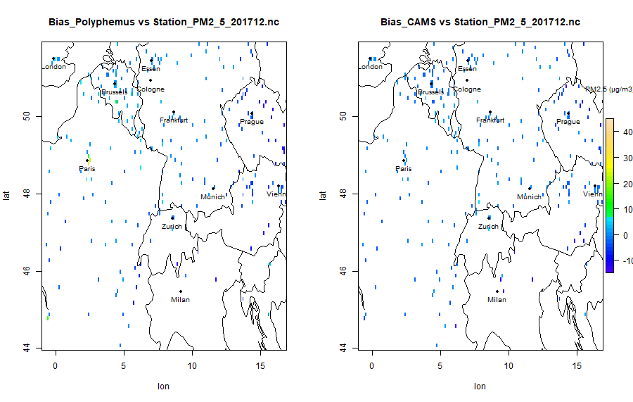
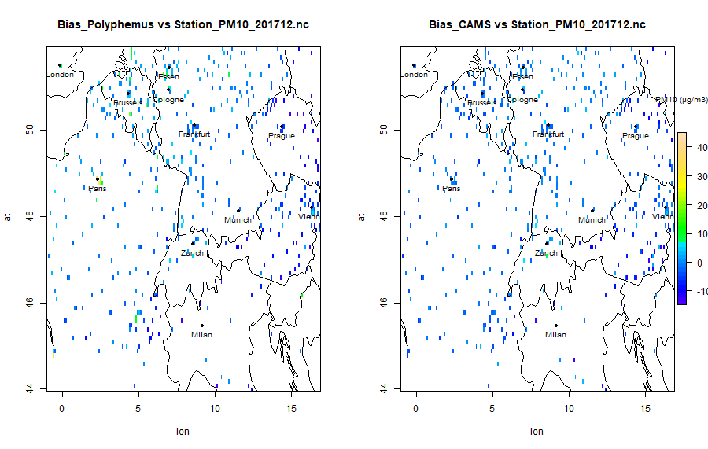
Statistical Indicators – Mean Bias: maps
Bias Polyphemus vs station PM2.5 – Dec 2017 Bias CAMS vs station PM2.5 – Dec 2017
Strong seasonal changes observed in all the pollutants.
The performance of Polyphemus in summer are better than CAMS with respect to station data.
Significant biases are observed for PM2.5 and PM10 in CAMS outputs with respect to station data (bias ranges -5 to 5)
The Alpine regions in northern Italy and some rural areas of southern France show a high positive bias for Polyphemus.
Bias Polyphemus vs station PM10 – Dec 2017 Bias CAMS vs station PM10 – Dec 2017

Slide 23
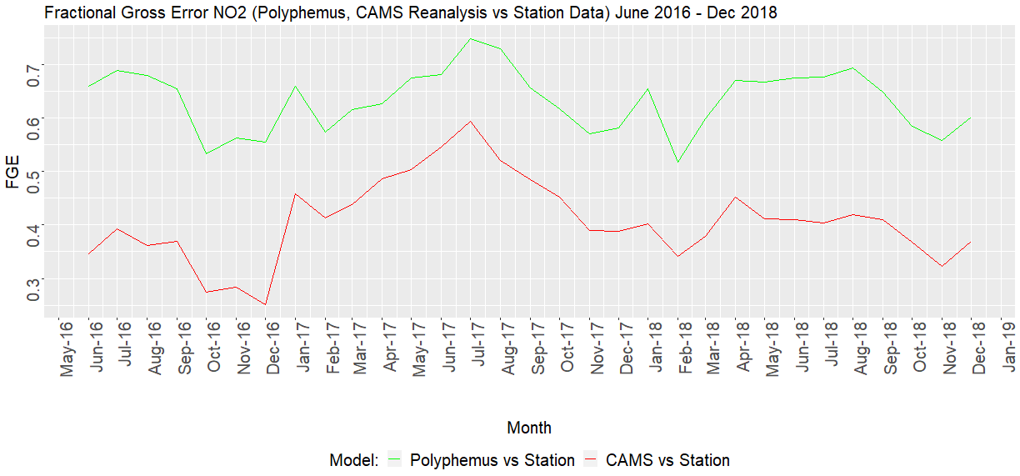
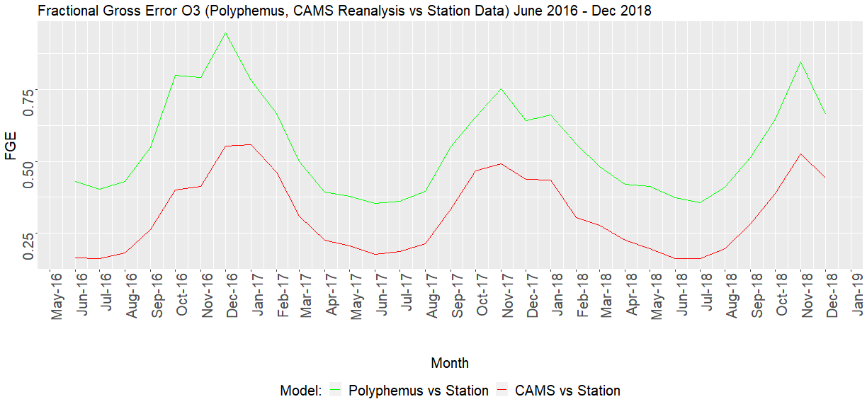
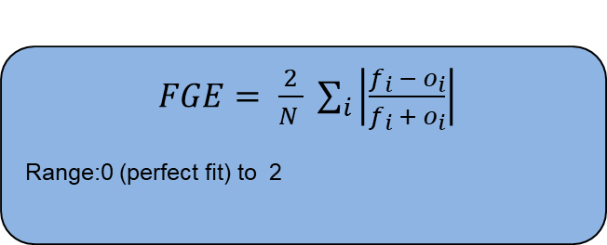
Statistical Indicators – FGE
$FGE= \frac{2}{N } \sum_{i}{\left|\frac{f_{i }− o_{i}}{f_{i }+ o_{i}}\right|}$
Range:0 (perfect fit) to 2
FGE observed with respect to station data for NO2 and O3

Slide 24
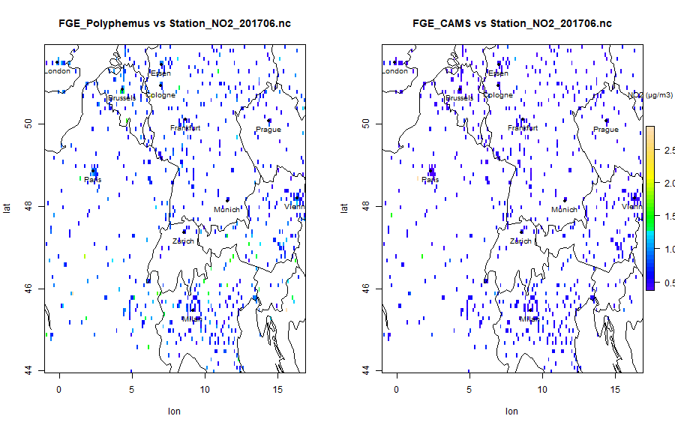
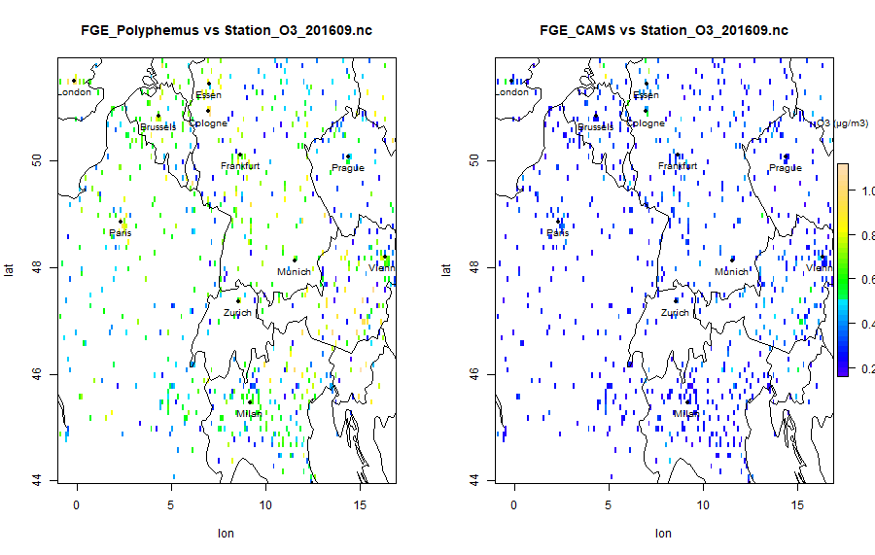
Statistical Indicators – FGE
FGE Polyphemus vs station NO2 – June 2017 FGE CAMS vs station NO2 – June 2017
FGE for both the models is less than 1.
A significant deviations in summer, especially in the urban regions. For winter, deviations between the models in the Alpine regions over Northern Italy and Southern Switzerland are easily noticeable.
The FGE for CAMS is closer to zero if compared to Polyphemus.
FGE Polyphemus vs station O3 – Sept 2016 FGE CAMS vs station O3 – Sept 2016

Slide 25
Statistical Indicators – Correlation coefficient
Blue: Polyphemus vs station,
Red: CAMS vs station
O3 Jan 2017
PM2.5 Jan 2017
NO2 June 2016
PM10 Mar 2018

Slide 26
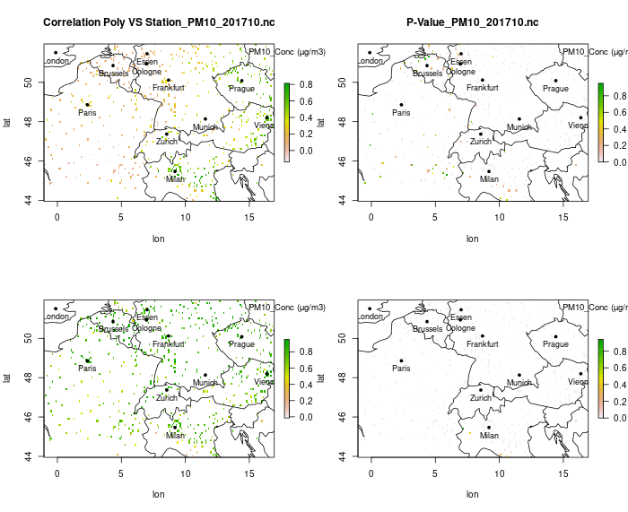
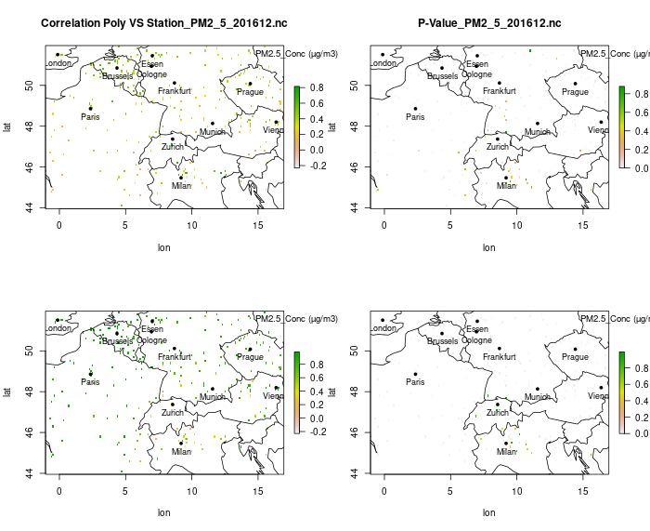
Statistical Indicators – Correlation coefficient
The average correlation coeffient for CAMS is 0.92 and for Polyphemus is 0.67 with respect to the station data.
From Correlation results, it was observed that Polyphemus performs better in winter
Correlation coefficient for O3 in CAMS are almost 1 for several months.
Poor correlation coefficient for PM10 and PM2.5 as low as 0.1 and 0.3 are due to outliers observed in Polyphemus.
Correlation CAMS vs Station PM10 201710 Correlation CAMS vs Station PM2.5 201612

Slide 27
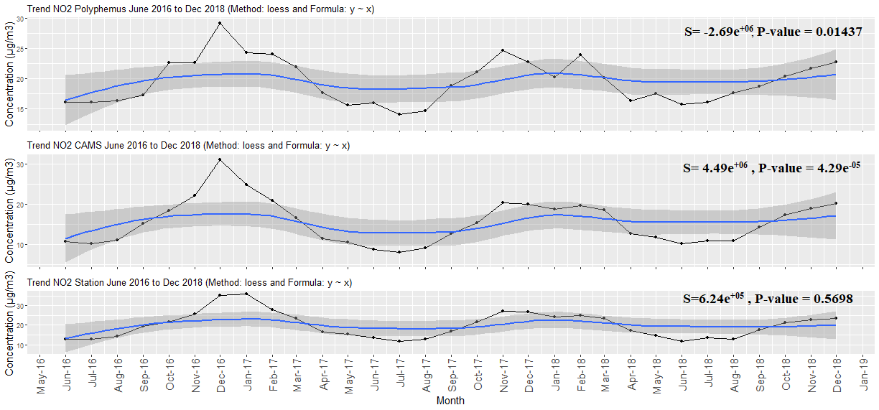
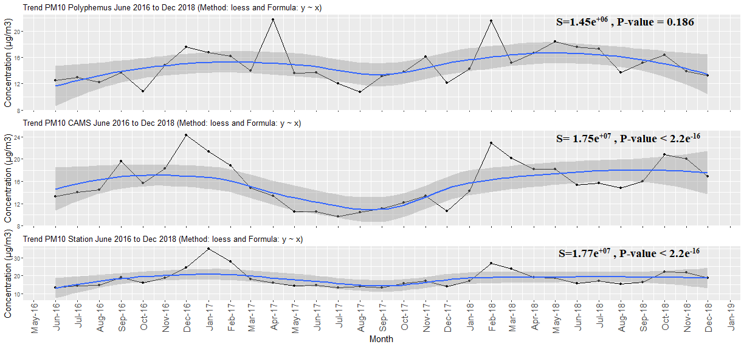
Temporal and Spatially varying trend
Strong seasonal variation was found in the models and the station data in the respective time window.
There is a regular fluctuations in model concentrations and station concentrations during summer and winter
There is a positive trend in both the model performances over the time window.

Slide 28
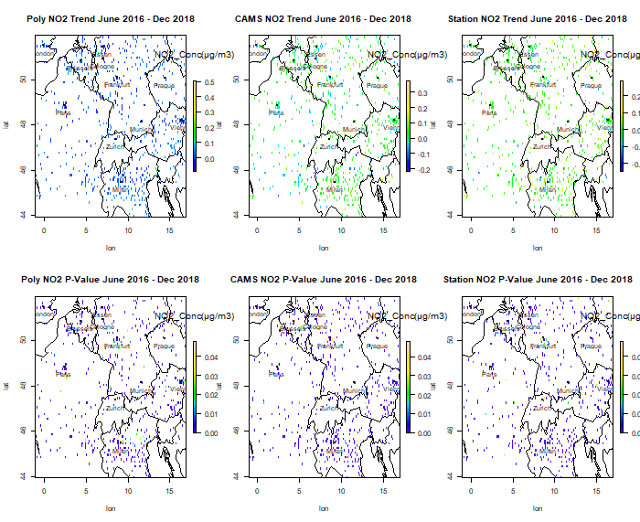
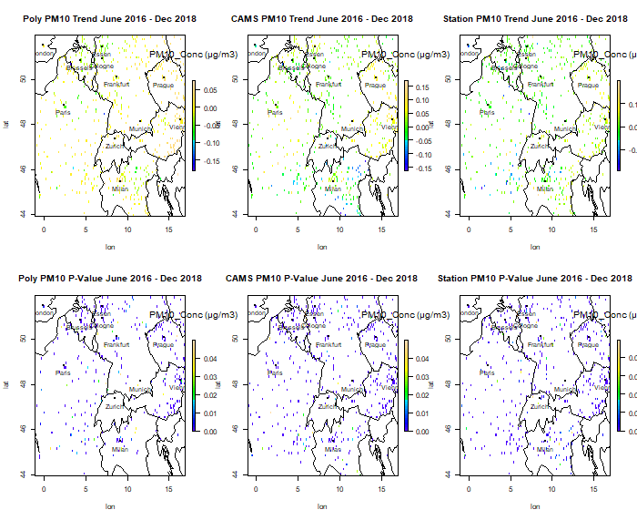
Spatial representation of temporal trend
Pixelwise Mann Kendall’s trend test.
Considerable differences in spatially varying trends between the models and the station data
Generally observable positive trend in cities and neutral and negative trends in rural areas for models and Station data.
Mild spatial variations for NO2 in Polyphemus with respect to station data.

Slide 29
Exploratory approach based on Artificial Intelligence (AI)
training data 75% testing data 25%
Parameters | Datasource | Input/Output
Date | Date series from June 2016 to Dec 2018. | Input
Precipitation | Polyphemus parameter | Input
Boundary layer height | Polyphemus parameter | Input
Surface wind velocity | Polyphemus parameter | Input
Solar radiations | Polyphemus parameter | Input
Polyphemus concentrations | Polyphemus parameter | Input
Surface pressure | Polyphemus parameter | Input
Surface temperature | Polyphemus parameter | Input
Month | Month series from June 2016 to Dec 2018. | Input
Season | Seasonal series from June 2016 to Dec 2018. | Input
Station concentrations | EEA air quality datasets | Output
RFR algorithm
model

Slide 30
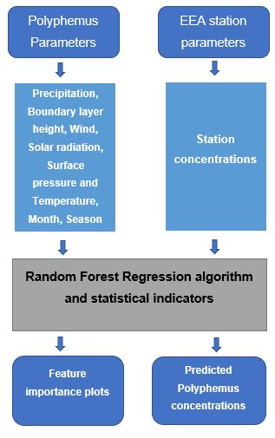
Methodology
Machine Learning Method – RFR

Slide 31
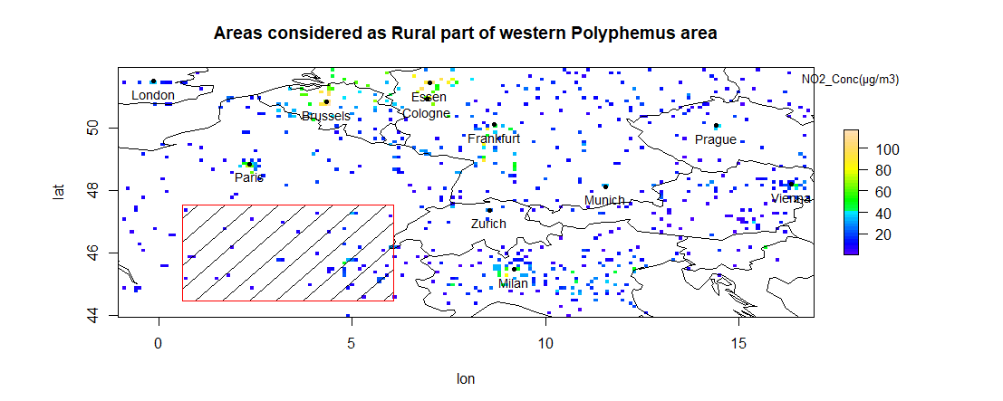
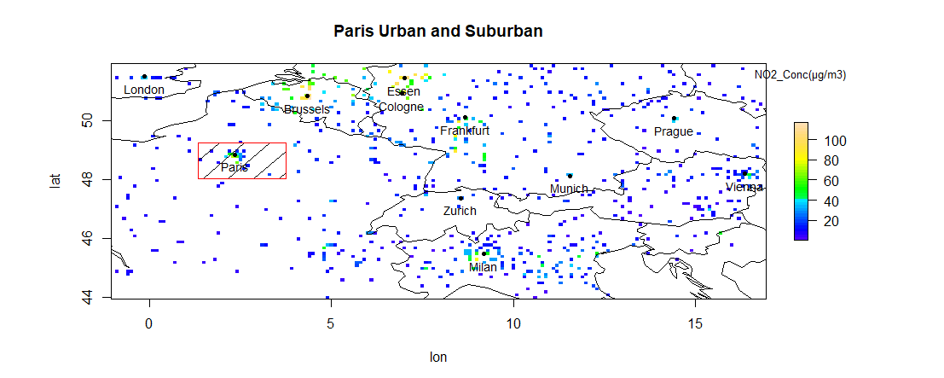
Exploratory approach based on Artificial Intelligence (AI)
Analyzed urban area (Paris and its suburban) and rural areas of Southern France in RFR.
Polyphemus parameters considered: Precipitation, Boundary height, wind, Solar Radiation, Surface Pressure, Surface Temperature, Month, Season FEATURES
Station Parameter considered: Station Concentrations TARGET
Investigating which input parameter of Polyphemus has greater importance in predicting station concentration

Slide 32
Results – Feature importance – NO2
Rural Area
Urban Area

Slide 33
Results – Feature importance – O3
Rural Area
Urban Area

Slide 34
Results – Feature importance – PM10
Rural Area
Urban Area

Slide 35
Results – Feature importance – PM2.5
Rural Area
Urban Area

Slide 36
Model Accuracy Assessment – Statistical Indicators The predicted concentrations has strong correlation with station concentrations than the actual Polyphemus concentrations.
 | NO2 | O3 | PM2.5 | PM10
%Var explained | 65.29 | 82.42 | 69.34 | 72.82
Correlation | 0.80 | 0.90 | 0.85 | 0.86
RMSE | 8.32 | 11.66 | 5.67 | 4.25
Mean Bias | -0.10 | -0.14 | 0.09 | -0.00042
FGE | 0.28 | 0.23 | 0.24 | 0.30
MAE | 6.15 | 8.90 | 4.12 | 2.88
Urban: Paris Metropolitan and its Suburban
 | NO2 | O3 | PM2.5 | PM10
%Var explained | 70.27 | 86.94 | 75.9 | 79.91
Correlation | 0.84 | 0.93 | 0.87 | 0.90
RMSE | 5.04 | 9.61 | 3.72 | 2.92
Mean Bias | 0.04 | -0.04 | -0.02 | -0.011
FGE | 0.25 | 0.15 | 0.18 | 0.21
MAE | 3.61 | 7.28 | 2.70 | 1.99
Rural: Southern France

Slide 37
Summary – Model - model station comparison
CAMS reanalysis are the datasets with data assimilation of station data. Therefore, the better comparison to stations.
There are also high biases observed in CAMS like negative bias for urban PM2.5, negative bias for rural NO2, positive bias for urban NO2 from station observations though the outputs are corrected using EEA air quality station datasets.
Outliers (extreme values) are observed in the Polyphemus outputs for PM10, PM2.5 time series especially in the urban regions.
Polyphemus tends to overestimate concentrations in cities especially for NO2, PM2.5 & PM10 while it slightly underestimate them in rural areas wrt EEA Station concentration.
Other than for O3, there is no significant differences in the performance of the models in day and night times.

Slide 38
Summary – AI Feature importance
Potential drivers from Polyphemus causing deviations in urban and rural areas:
For NO2 & PM10: boundary layer height, seasons and wind.
For O3: surface pressure, seasons & month.
For PM2.5: precipitation, boundary layer height, seasons and month.
The RFR algorithm performs well in rural regions showing better accuracy with respect to station observations.
Good correlation significance was observed with respect to station concentrations in both the urban and rural regions.
PM10 and PM2.5 show varying results compared to other pollutants in rural areas.

Slide 39
Future developments
Using satellite data (Sentinel-5P) along with station measurements as truth data for model comparison.
Verify statistical variations between models, station, and satellite datasets.
The feature importance analysis could be extended to additional Polyphemus parameters.

Slide 40
Thank you !
Queries & Suggestions?

